Slide 1

FED
WE
E
K
Introduction to Cascading Style Sheets
Typography
Layouts
Front End Development
Diploma in CSF
Year 1 (2021/22), Semester 2
3

Slide 2
Remote Learning Instructions
Step 1
Read the given slides
Details in slide 1-12
Step 2
Perform highlighted activities in Activities slide
Details in slide 13
Step 3
Complete and Submit Tasks given
Details in slide 14

Slide 3
Learning Objectives
Basic concepts used when creating style sheets
Various ways to select elements from your HTML document
Apply CSS to arrange text and image contents for better readability and presentation.

Slide 4
Topics
Introduction to Cascading Style Sheets (CSS)
Benefits of CSS
How Style Sheets Work
CSS Concepts
Typography
Colours and Background
Font Properties
Text Decorations
Layout
Margin and Padding
Float

Slide 5
Introduction
CSS is a language that describes the style of an HTML document.
CSS describes how HTML elements are to be displayed on screen, paper, or in other media.
CSS saves a lot of work. It can control the layout of multiple web pages all at once.

Slide 6
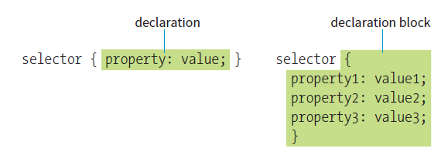
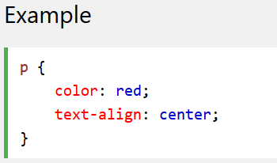
CSS Syntax
Selector points to the HTML element you want to style.
Declaration block (surrounded by curly braces { }) contains one or more declarations separated by semicolons.
Each declaration includes a CSS property name and a value, separated by a colon.

Slide 7
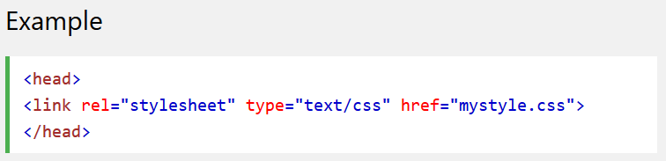
Attaching Styles to Document (1)
External Style Sheet
With an external style sheet, you can change the look of an entire website by changing just one file!
Each page must include a reference to the external style sheet file via a <link> element inside the <head> section:
Inside mystyle.css:
body { background-color: lightblue; } h1 { color: navy; margin-left: 20px;}

Slide 8
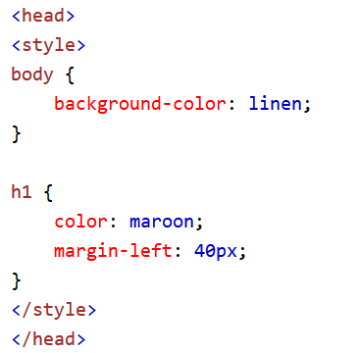
Attaching Styles to Document (2)
Internal Style Sheet
An internal style sheet may be used if one single page has a unique style.
Internal styles are defined within the <style> element, inside the <head> section of an HTML page, e.g.,:

Slide 9
Attaching Styles to Document (3)
Inline Styles
An inline style may be used to apply a unique style for a single element.
To use inline styles, add the style attribute to the relevant element. The style attribute can contain any CSS property.
The example below shows how to change the color and the left margin of a <h1> element:

Slide 10
Style Sheets Cascading Order
If some properties have been defined for the same selector (element) in different style sheets, the value from the last read style sheet will be used.
All the styles in a page will "cascade" into a new "virtual" style sheet by the following rules, where number one has the highest priority:
Inline style (inside an HTML element)
External and internal style sheets (in the head section)
Browser default

Slide 11
Resume Styling (CSS)
Video on CSS (reference for worksheet)
https://www.linkedin.com/learning/css-essential-training-3/styling-documents-consistently
Tasks | Videos
Chapter 1: Getting Started | Project: Relative Path (4m 35s)
Chapter 2: Core Concepts | Project: Adding Colors (6m 18s) Project: Styling Links (8m 5s)
Chapter 3: The Box Model | Project: Adding Content Wrappers (5m 8s) Project: Margin and Padding (6m 20s)
Chapter 4: Typography | Project: Google Fonts (4m 3s) Project: Typography Styles (4m 7s)
Chapter 5: Layouts – Floats and Positions | Project: Float and Box Model Fix (5m 49s)
NB: To access video, sign in using your NP account

Slide 12

Reference
Learning Web Design
A Beginner’s Guide to HTML, CSS, JavaScript and Web Graphics
Jennifer Niederst Robbins
Chapter 11 to 15
Available to download from NP library:
https://ebookcentral.proquest.com/lib/np/detail.action?docID=5412749&query=Learning+Web+Design
Lynda.com:
CSS Essentials Training 1

Slide 13
Activities
Watch the video course under the topic CSS Essentials Training from the link below.
https://www.linkedin.com/learning/css-essential-training-3/styling-documents-consistently
You need to sign in with your email address to view the full video.
Read the following chapters from the textbook as reference materials.
Chapter 11 – Introducing Cascading Style Sheets
Chapter 12 – Formatting Text
Chapter 13 – Colours and Background
Chapter 14 – Thinking inside the Box

Slide 14
Tasks
Complete Week 3 Practical.
Download Week 3 Practical in MEL – “FED 2021-10 Week 3 Worksheet.pdf”
Deadline end of Week 3
Submit the completed practical files in MEL.
Zipped the source files
Name the zipped file in following format:-
FED-Week03-SXXXXXXXX (where SXXXXXXXX is your student id)
Submit the zipped file in the weekly folder’s submission link in MEL
Also, submit the zipped file into FED network folder (https:///ictspace.ict.np.edu.sg/FED) under your studentID. This is for backup purpose only. Main submission is still in MEL.
If you have any questions please communicate with your tutor via Microsoft Teams.

Slide 15
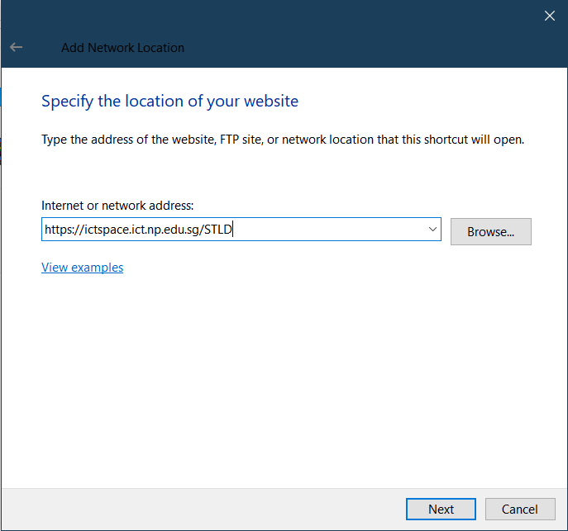
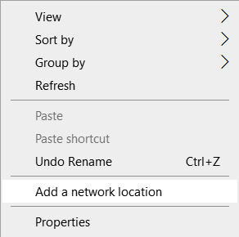
Appendix
Mapped to FED network folder
For Win Users
Right click on a blank space in your Windows Explorer
Select ‘Add a network location’
3. Enter https://ictspace.ict.np.edu.sg/(your assigned module)
4. Press ‘Next’

Slide 16
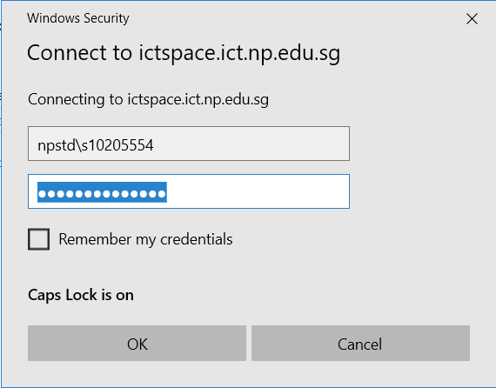
Appendix (Cont)
10123453
4. Login using npstd\s(your student ID number without the last alphabet)
5. Enter your NP student account password

Slide 17
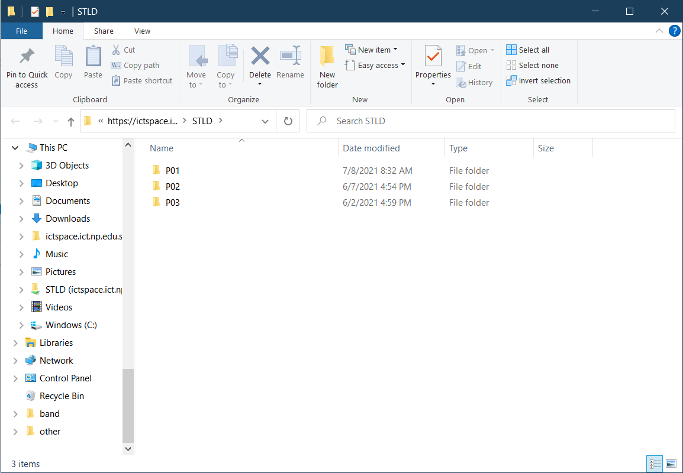
Appendix (Cont)
You should be able to see your class folder as shown in the example below.

